Slide 1

What is Delay Tolerant Networks?

Slide 2
Delay Tolerant Networks
DTN architecture expects nodes to store bundles for an extended period.
Whenever possible, each received data packet is forwarded immediately.
If forwarding is not currently possible but is expected to be possible in the future, the packet is stored for future transmission.

Slide 3
Delay Tolerant Networks
A Simplified Introduction to Disruption-Tolerant Networking – YouTube

Slide 4
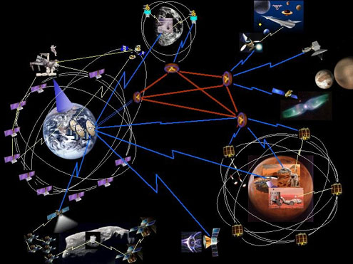
Interplanetary communication
Ref: [1]
Picture: http://www.intel-research.net/berkeley
Notes:
Today’s network applications must communicate across totally different networking environments with different link characteristics. Interplanetary Internet that includes both terrestrial and interplanetary links is an extreme case of DTN. Under water marine communication, sensor networks, satellite communication and etc.

Slide 5



ZebraNet (a real life application)
Tracking node with CPU, FLASH, radio and GPS
Data
Store-and-forward communications
Data
Data
Data
First deployment in 2004 in Kenya
Sensor Network Attributes | ZebraNet | Other Sensor Networks
Node mobility | Highly mobile | Static or moderate mobile
Communication range | Miles | Meters
Sensing frequency | Constant sensing | Sporadic sensing
Sensing device power | Hundreds of mW | Tens of mW
http://www.princeton.edu/~mrm/zebranet.html
Notes:
Application is using mobile computation for real biological research using sensors installed on real zebras.
ZebraNet is a power-aware wireless ad hoc sensor network,
the goal is to use systems to perform novel studies of animal migrations and inter-species interactions.

Slide 6
DTN characteristics
Internet environment
  End-to-end RTT is not large.
  Some path exists between endpoints.
  E2E reliability using ARQ works well.
  Packet-switching is the right abstraction.
DTN characteristics
  Very large delays.
  Intermittent and scheduled links.
  Different network architectures.
  Conversational protocols fail.
  No ARQ.
Ref: [2], [3]

Slide 7
What is VANET ?

Slide 8
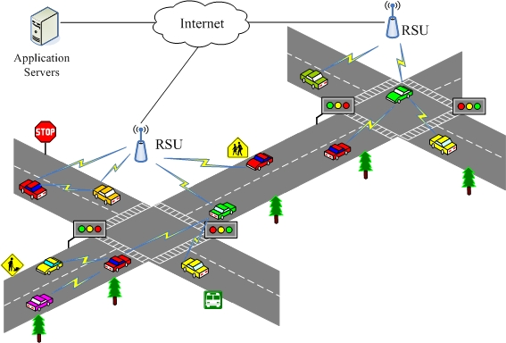

Slide 9
What is VANET
Vehicular Ad–Hoc Network, or VANET
a form of Mobile ad-hoc network
provide communication
- among nearby vehicles
- between vehicles
- nearby fixed equipment

Slide 10
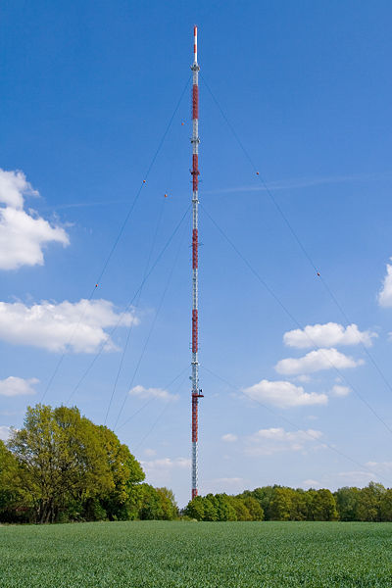
Introduction
How vehicular communications work
- road-side infrastructure units (RSUs),
named network nodes, are equipped
with on-board processing and wireless
communication modules

Slide 11
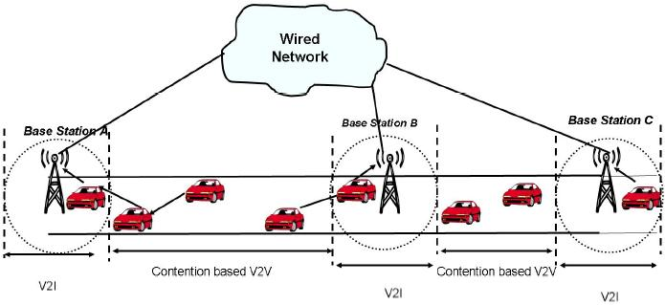
How vehicular communications work (Continue)
- vehicle-to-vehicle (V2V) and vehicle-to-infrastructure
(V2I) communication will be possible

Slide 12
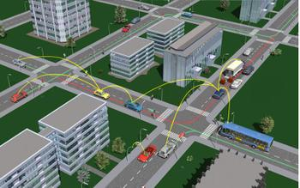

Slide 13

What can VANET provide ?

Slide 14
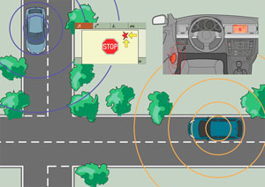
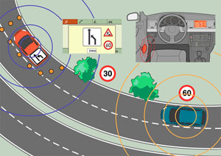
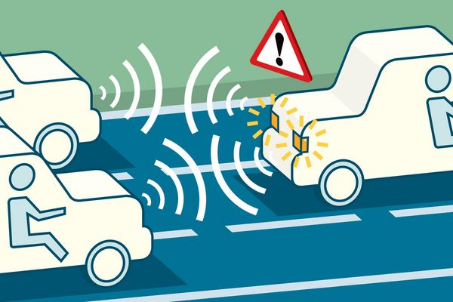
Warnings!!!

Slide 15

Warnings!!!

Slide 16
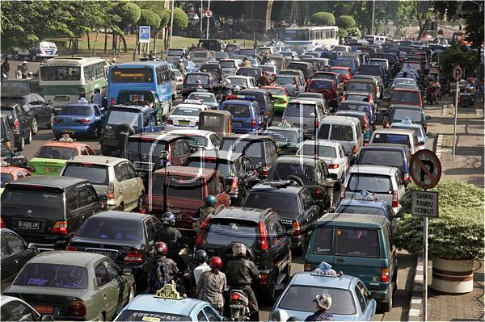

traffic and road conditions

Slide 17
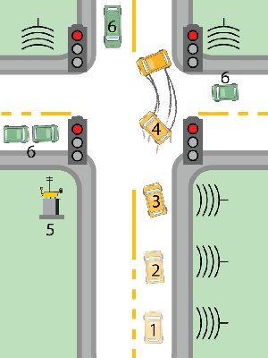
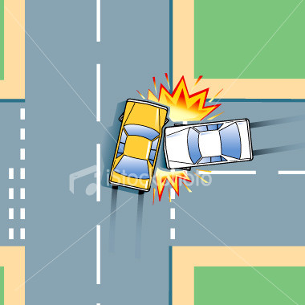
traffic and road conditions

Slide 18
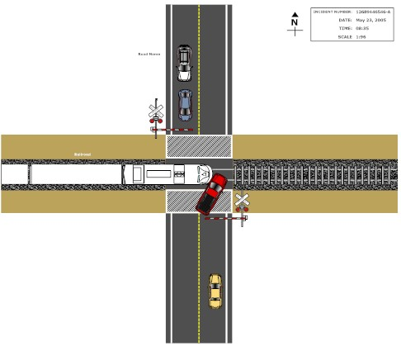

Slide 19
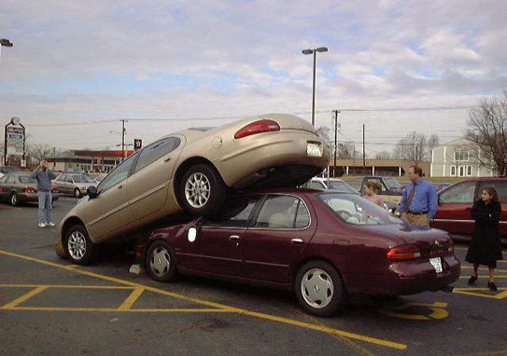
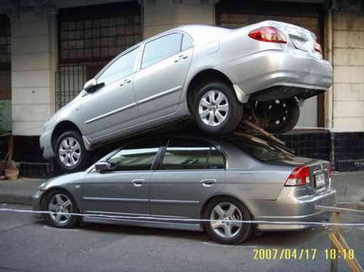

Slide 20
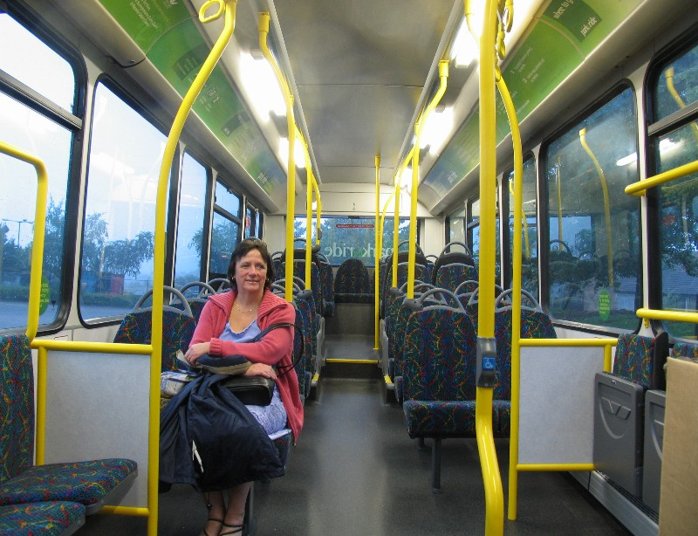
What can VANET provide
The VANET can provide
Safety
Efficiency
Traffic and road conditions
Road signal alarm
Local information

